Slide 1


Why Not: Empowering Your Energy Journey
Introducing Why Not, the revolutionary energy tracker that puts you in control of your well-being. By monitoring your energy levels and providing personalized insights, Why Not empowers you to make informed decisions and live your best life.

Slide 2

Connecting with Energetic People
Many people want to go outside and meet new, high-energy people to engage in fulfilling activities together.
Seeking Energizing Experiences
People desire to meet energetic individuals and participate in exciting, rejuvenating experiences.

Slide 3
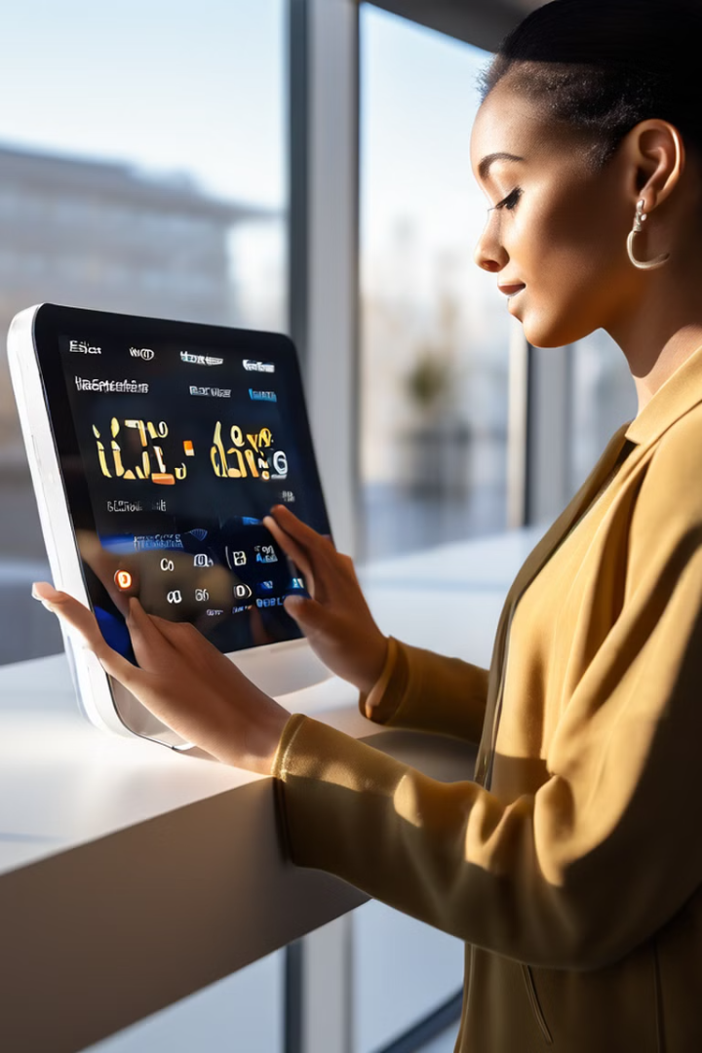
The Solution: Why Not Energy Tracker
1
Track Your Energy
Why Not seamlessly integrates with your daily routine, allowing you to monitor your energy levels throughout the day.
2
Personalized Insights
Our advanced algorithms analyze your data to provide tailored recommendations for optimizing your energy and productivity.
3
Encouragement and Support
Why Not motivates you with personalized encouragement, helping you stay on track and achieve your energy goals.

Slide 4
Key Features: Empowering Your Energy
Energy Tracking
Comment and Reflect
Encouragement and Motivation
Seamlessly monitor your energy levels throughout the day, gaining valuable insights into your body's rhythms.
Easily add comments to your energy logs, allowing you to reflect on your experiences and track patterns.
Receive personalized encouragement and tips to help you maintain your energy levels and reach your goals.

Slide 5

Future Enhancements: Expanding Your Horizon
Social Integration
Event Scheduling
Energy Mapping
Connect with a community of like-minded individuals, share your energy progress, and offer support.
Easily sign up for energy-boosting events and activities, integrating them seamlessly into your daily life.
Visualize your energy patterns on a heat map, empowering you to identify and address areas of concern.

Slide 6
Wearables: Capturing a Booming Market
The wearable tech market is experiencing remarkable growth, projected to reach a value of ~$150 billion by 2023. With a forecasted ~20% CAGR from 2024 to 2030, this industry is poised for continued expansion.
Revenue Breakdown
Fitness Trackers:
~$50 billion
Smartwatches:
~$60 billion
Other Wearables:
~$40 billion
1
Target Age Group
2
Market Expansion Opportunities
18-50 years old
Corporate wellness and emerging markets
Key Players
Fitbit, Apple, Garmin, Whoop

Slide 7






Our Team
Sania Bandekar
Sahithi Nara
Adhira Deogade
Presentation
Database
APIs
Sergei Terekhov
Nature
Christoph Bartschat
Features
Landing Page
APIs

Slide 8




SHOWCASING DEMO &JOIN US
Download Why Not
Get the app and start your energy transformation today.
Explore the Features
Discover how Why Not can help you achieve your goals.
Share Your Story
Join our community and inspire others with your energy journey.

